Slide 1
Power BI DevOps

Slide 2
Agenda
Why do you need it?
Different Options
Demo

Slide 3
DevOps for Power BI Why do you need it?

Slide 4
Why Power BI DevOps?
Parallel Development
Version Control
Sync with Data Platform Environments
Apply Software Engineering Best Practice
Standardization/Automation
Facilitate Planning

Slide 5
DevOps for Power BI Different Options

Slide 6

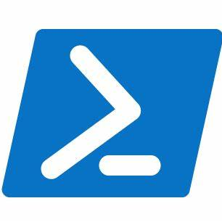


Different Options for Power BI DevOps
Deployment Pipelines
PowerShell
Tabular Editor
Azure DevOps
GitHub

Slide 7
Power BI DevOps with Deployment Pipelines
Advantages
Weaknesses
Easy to learn/use
Compare environments
Manage connection string changes
Auto-Binding
Azure DevOps Extension
No rollback
Does not handle some complex scenarios
No DevOps integration in UI
Premium or PPU only
Publish
Deploy
Desktop
Deployment Pipelines

Slide 8
Power BI DevOps with PowerShell
Advantages
Weaknesses
Customisable
Cater for some complexities (Gateway Binding etc)
Does not require Premium or PPU
Need some PowerShell knowledge
Limited Cmdlets
No detailed comparison
Need to check in PBIX
Check in
Deploy
Desktop
or
Publish
Deploy
Update
Desktop
Deployment Pipelines

Slide 9
Power BI DevOps with Tabular Editor
Advantages
Weaknesses
Metadata serialization
Enables parallel development
Best Practice Analyzer for testing
CLI run from Azure Pipelines or Github Actions
No model view ( Tabular Editor 2)
Learning curve for Tabular Editor and CLI
Only applicable for datasets, not other Power BI artefacts
Check in
Deploy
Datasets
XMLA
Connect
Publish
Deploy
Reports
PBI Service
Desktop
Deployment Pipelines

Slide 10
DevOps for Power BI Hands-on Demos

Slide 11
Hands on with Deployment Pipelines
Liping Huang

Slide 12
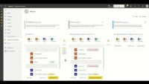

Slide 13
Hands on with PowerShell
Liping Huang

Slide 14
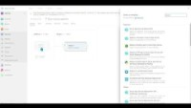

Slide 15
Hands on with Tabular Editor
Liping Huang

Slide 16
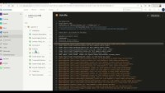

Slide 17
Resources
Session specific resources: Power BI DevOps
Blog : Tabular Editor DevOps Blog Series
👉https://aka.ms/build/uk/tab-editor
Docs : Get started with deployment pipelines
👉https://aka.ms/build/uk/deployment
Docs: PowerShell Cmdlets reference 👉 https://aka.ms/build/uk/powershell
Docs: Automate your deployment pipeline using APIs and Azure DevOps
👉https://aka.ms/build/uk/auto-deploy

